Slide 1
Intermediate Presentation Bachelor Thesis Deep embedded Music Fabian Gröger
17.04.2020
Notes:
Welcome Mister Callner, Mister Daly, Mister Lionetti, Mister Oehri and Mister Pfäffli
Introduce myself
Introduce the presentaiton

Slide 2
Agenda
Project overview
Project management
Related Work
Datasets used
Ideas and concepts
First results
Summary and outlook
Q&A

Slide 3
Project Overview: Unsupervised embedding space for audio
Idea
Create an embedding space for audio, where distances have meaning
Adapt Tile2Vec, an image embedding algorithm, to audio
Evaluate the performance on the DCASE 2018 task 5 dataset
Use unsupervised machine learning to embed samples
Train a simple classifier on the embeddings
The resulting embedding algorithm should be applied exploratively to music
To-Do
Adapt Tile2Vec algorithm to music with Tensorflow 2.0
Find an appropriate audio feature to represent the samples
Find an embedding architecture based on neural networks
Evaluate the architecture on a music dataset

Slide 4
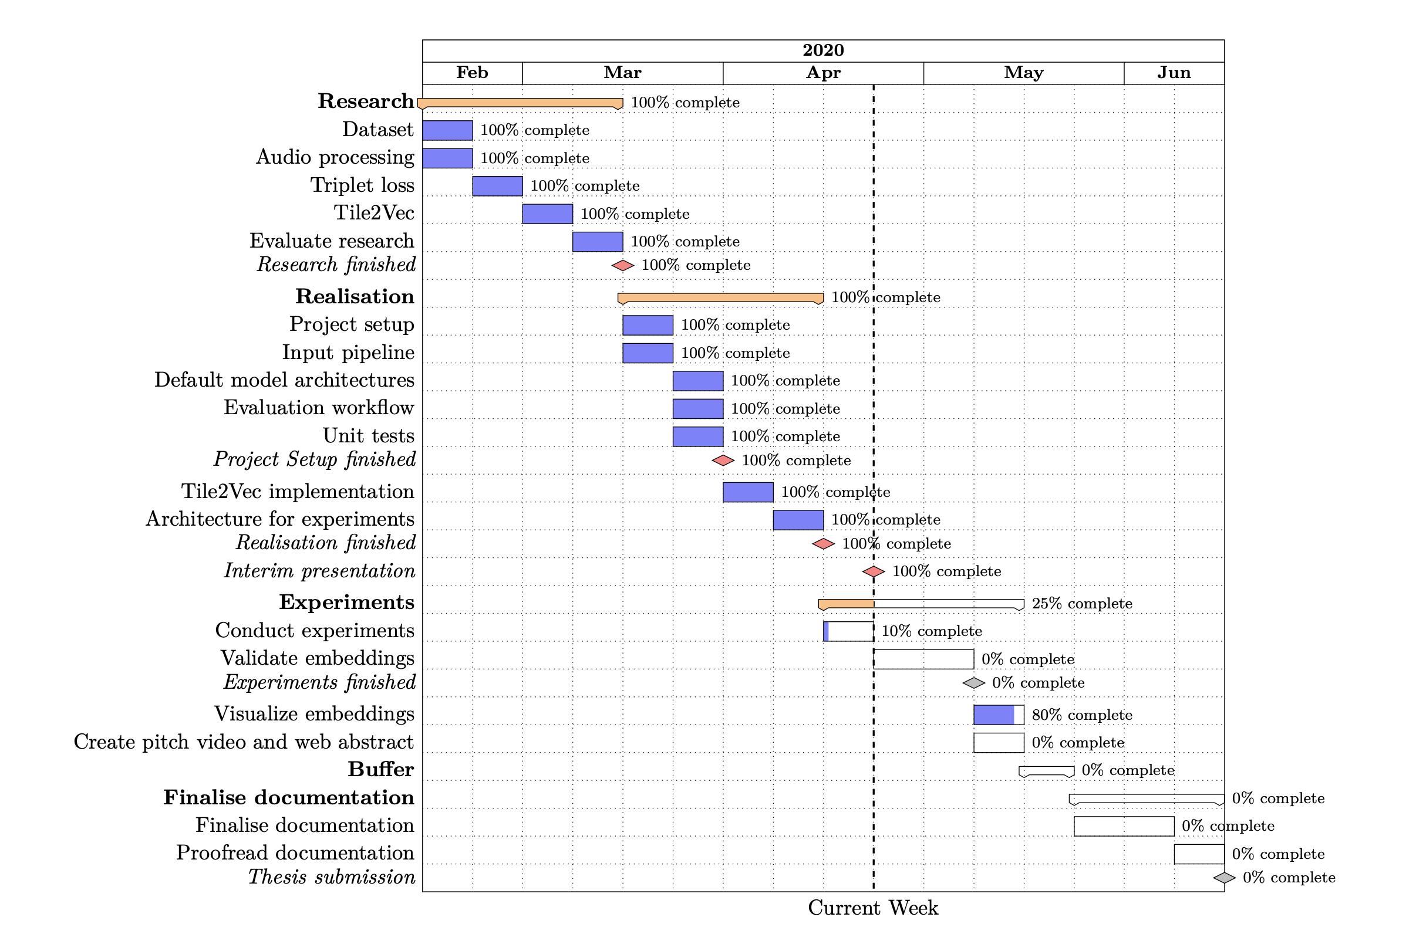
Project Management
Notes:
Project duration: 17. February to 5. june
Four phases including a buffer phase
Research
Build foundations
Research approaches / concepts
Realisation
Put together define
Realization and experiments
Two cicles
High-level, low-level
Finalize documentation
Documentation related and project assignments

Slide 5
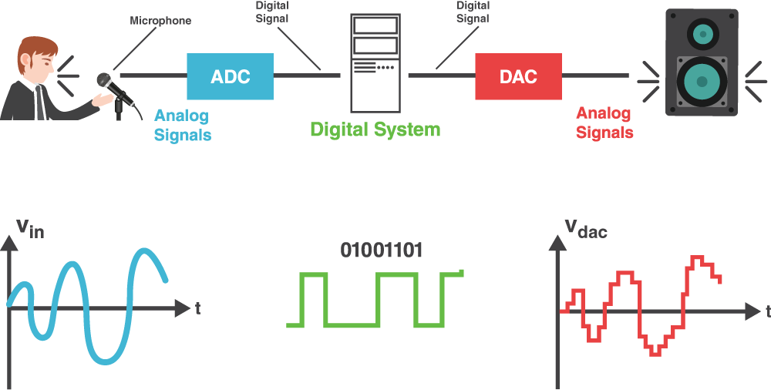
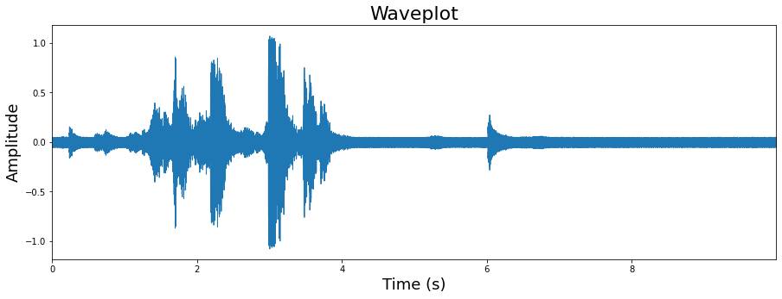
Related Work: Intro to Digital Signal Processing
Digital Signal Processing (DSP) takes a real-world signal which has been digitised and mathematically manipulates it
Converters such as an Analog-to-Digital converter (ADC) and Digital-to-Analogue (DAC) take a real-world signal and turns it into a digital format and vice-versa
Sound signals can be defined as pressure variations travelling through the air, which can be described as waves and therefore often called sound waves
Raw waveform: representations of a signal in the time-domain y-axis: represents amplitude x-axis: represents the time
References: [1] [2]
Notes:
Signals need to be processed so that the information they contain can be analysed
Time domain: shows how a signal changes with time

Slide 6
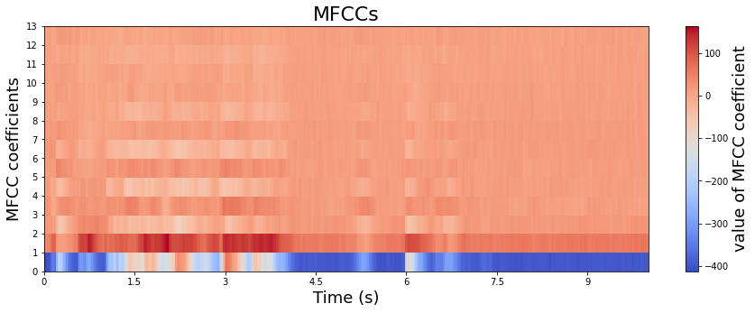
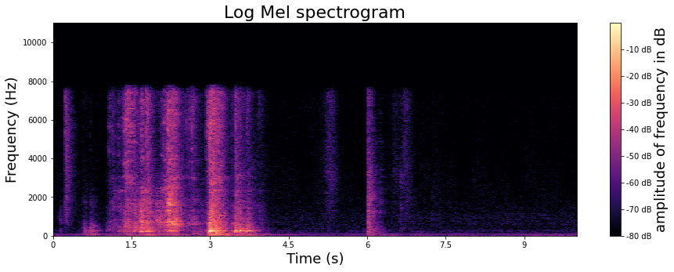
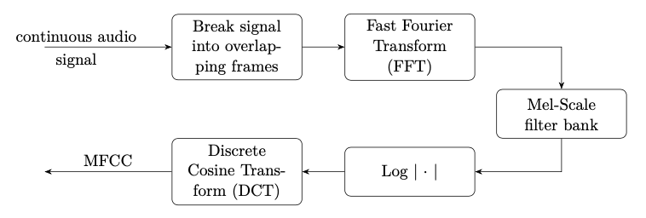
Related Work: Intro to Digital Signal Processing
Spectrogram: visual representation of the spectrum of frequencies of a signal as it varies with time x-axis: time y-axis: frequency colours: magnitude of the frequency at a time
Mel Frequency Cepstral Coefficients (MFCC) focus on the audio signal and discard information such as background noise
MFCC were designed to mimic the human hearing
Log Mel spectrogram: visual representation of the frequencies in the log Mel scale
References: [2]

Slide 7
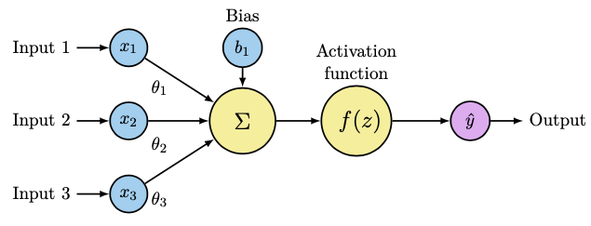
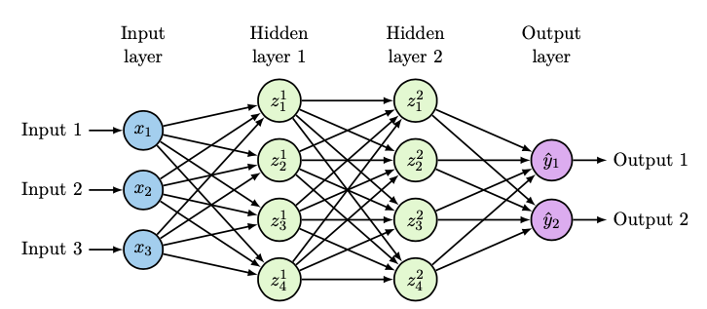
Related Work: Intro to Neural Networks
Artificial Neural Network (ANN or NN) is a computational model that is inspired by the way the brain works
NN consists of many neurons (Preceptrons)
Preceptrons consist of input(s), a bias and an activation function which are used to calculate an output
Feedforward Neural Networks contain multiple nodes arranged in layers, where each node is connected to the adjacent ones and information only moves forward
Multi Layer Preceptron (MLP) contains an input, output and one or more hidden layers
References: [3]

Slide 8
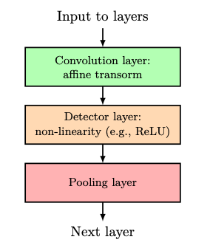
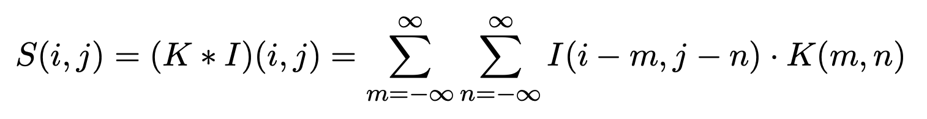
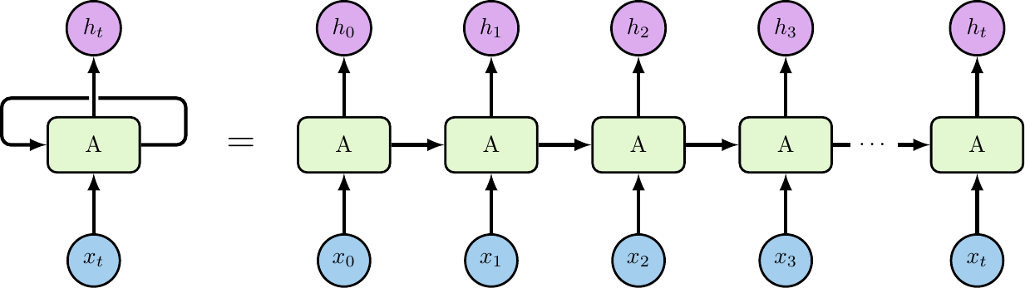
Related Work: Intro to Neural Networks
Convolutional Neural Network (CNN) specialise in working with grid like data (e.g. sound, images)
CNN are networks that use convolution in place of general matrix multiplication in at least one of their layers
Gated Recurrent Unit (GRU) belong to the family of recurrent neural network (RNN), which focus on processing sequential data
RNNs use a cyclic loop to pass the information from the step before to the next along with the input of the current step
GRU were introduced to solve the vanishing gradient problem in RNNs (input from far behind looses importance)
GRU have two gates, an update and reset gate which decide what information will be passed to the output
References: [3]

Slide 9
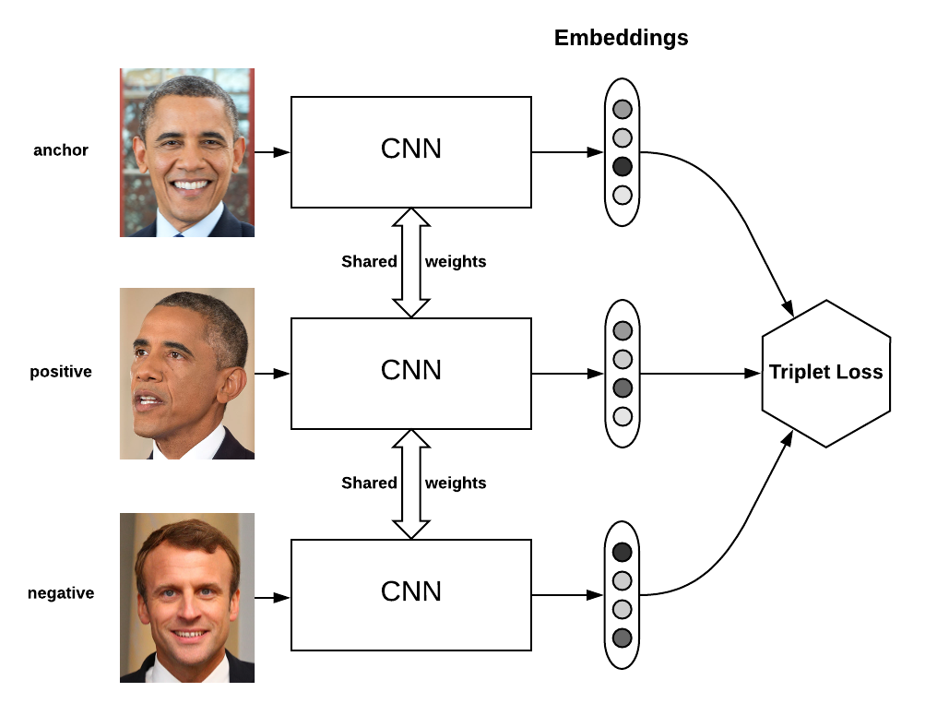
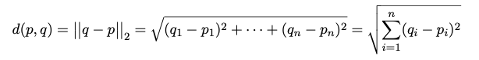
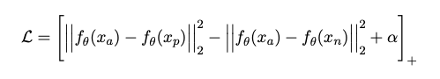
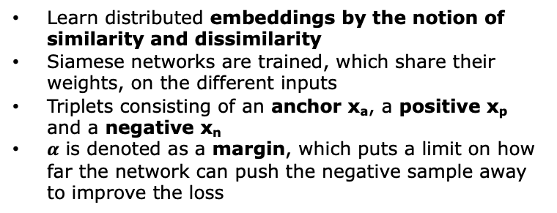
Related Work: Triplet Loss
Learn distributed embeddings by the notion of similarity and dissimilarity
Siamese networks are trained, which share their weights, on the different inputs
Triplets consisting of an anchor x_{a}, a positive x_{p} and a negative x_{n}
$α$ is denoted as a margin, which puts a limit on how far the network can push the negative sample away to improve the loss
References: [4] [5]
Notes:
Introduced by Google for face recognition
positive sample is similar to the anchor and negative one is dissimilar to the anchor
notation [⋅]+ to represent a rectifier, max(0,⋅)

Slide 10
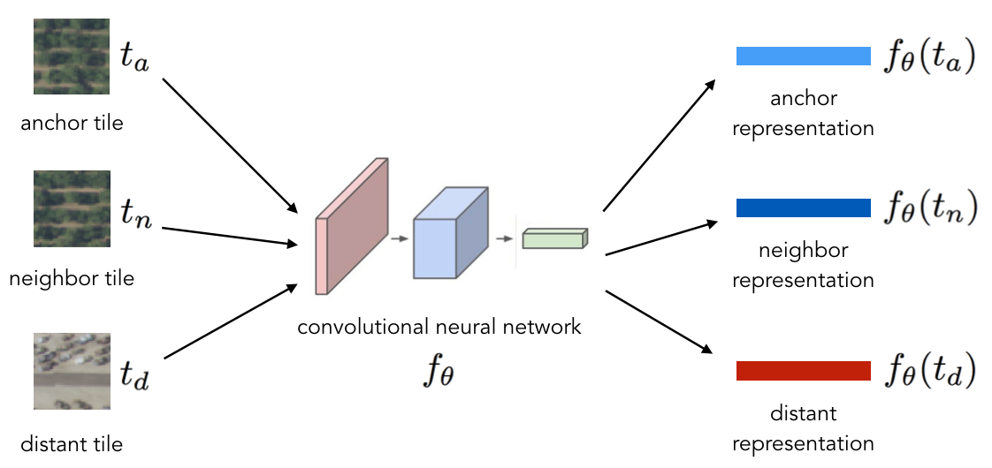
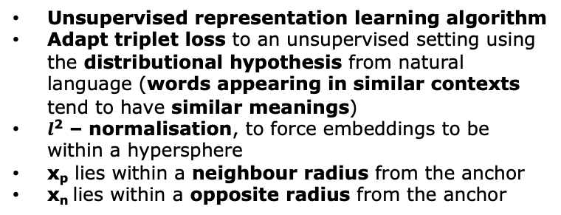
Related Work: Tile2Vec
Unsupervised representation learning algorithm
Adapt triplet loss to an unsupervised setting using the distributional hypothesis from natural language (words appearing in similar contexts tend to have similar meanings)
$l$² – normalisation, to force embeddings to be within a hypersphere
x_{p} lies within a neighbour radius from the anchor
x_{n} lies within a opposite radius from the anchor
References: [6] [7]
Notes:
Introduced by Stanford University
positive sample is similar to the anchor and negative one is dissimilar to the anchor

Slide 11
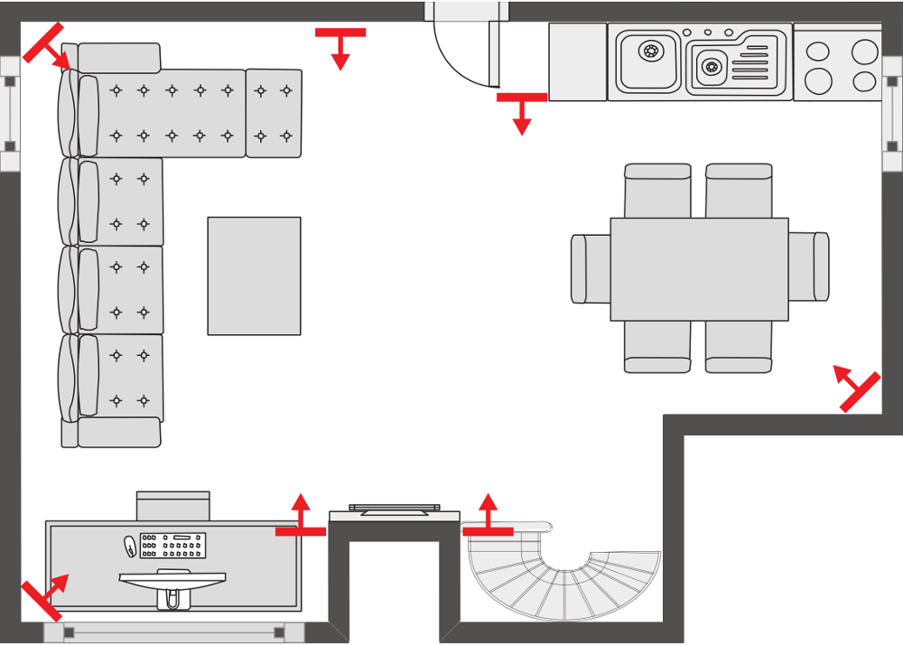
Datasets used: DCASE Challenge 2018 – Task 5 dataset
Derivative of the SINS dataset, a continuous recording of one person living in a vacation home over a period of one week
DCASE: 7 microphone arrays (4 linearly arranged) in the combined living room and kitchen
Continuous recordings were split into audio segments of 10s
Each audio segment contains 4 channels
As development set, approximately 200 hours of data from 4 sensor nodes along with the ground truth is given
As evaluation set, data is provided from all the sensor nodes
Winner: IBM Team, macro-averaged F1 score of 88.4%
References: [8]
Notes:
Segments containing more then one active class (e.g. a transition of two actitivies) were left out! This means that each segments represents one activity
As evaluation set, data is provided from all the sensor nodes (i.e. also sensor nodes not present in the development set)
The evaluation will be based on the sensor nodes not present in the development set.
The data from the same nodes as in training are provided to give insights about the overfitting on those positions.

Slide 12
Datasets used: DCASE Challenge 2018 – Task 5 dataset
Activity | # 10s segments | # sessions
Absence (nobody present in the room) | 18860 | 42
Cooking | 5124 | 13
Dishwashing | 1424 | 10
Eating | 2308 | 13
Other (present but not doing any relevant activity) | 2060 | 118
Social activity (visit, phone call) | 4944 | 21
Vacuum cleaning | 972 | 9
Watching TV | 18648 | 9
Working (typing, mouse click) | 18644 | 33
Total | 72984 | 268
References: [8]
Notes:
The daily activities for this task are shown in Table along with the available 10s multi-channel segments in the development set and the amount of full sessions of a certain activity (e.g. a cooking session).

Slide 13
Datasets used: Music Dataset
7 different music genres with 30 songs each
Songs classified by genre according to Beatport.com
Approximately 18 hours of audio recordings
Songs vary in length, from 3min to 10min
Single channel .mp3 files
Music genre | # songs
Deep House | 30
Electronica Downtempo | 30
Indie Dance | 30
Melodic House and Techno | 30
Techno Peak Time Driving Hard | 30
Techno Raw Deep Hypnotic | 30
Trance | 30
Total | 210

Slide 14
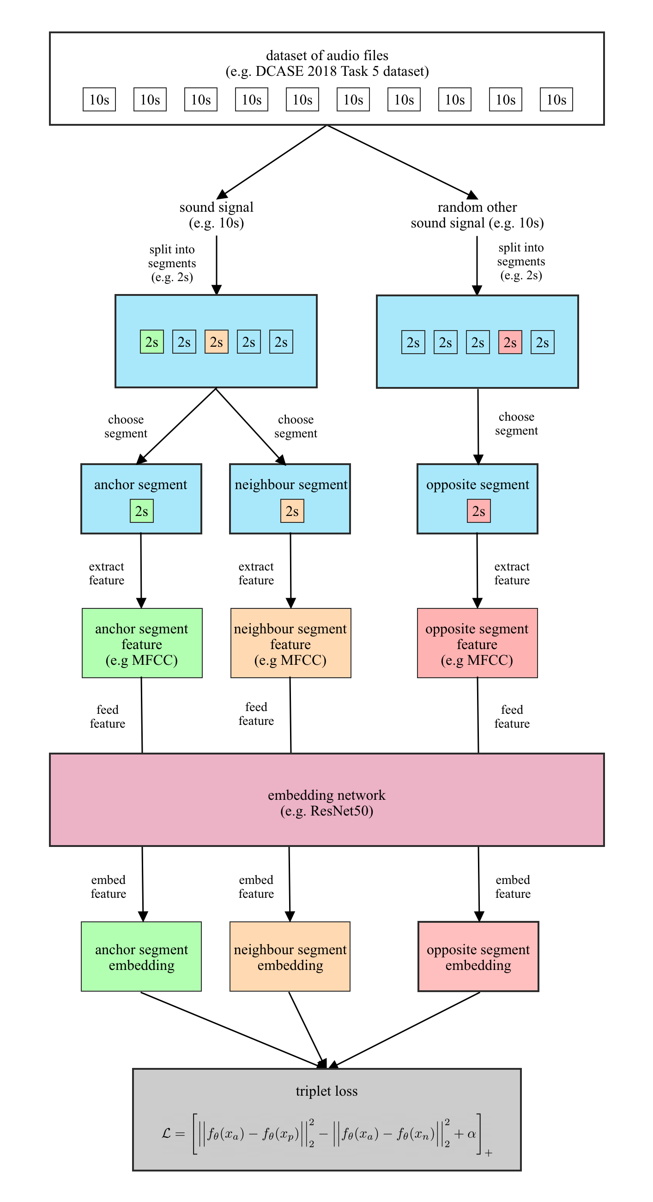
Ideas and Concepts
Data pre-processing: None
Feature extraction: Raw waveform, log Mel spectrogram, MFCC
Data augmentation: Shuffling and mixing
Triplet selection: Songs split into segments, anchor neighbour belong to same audio, opposite belongs to a different
Models: state-of-the-art CNN, GRU, CRNN architectures
Application to music: same as for noise detection set
Metrics: Embedding: triplet loss, distance to neighbour and opposite Classifier: loss, accuracy, macro-averaged F1 score

Slide 15
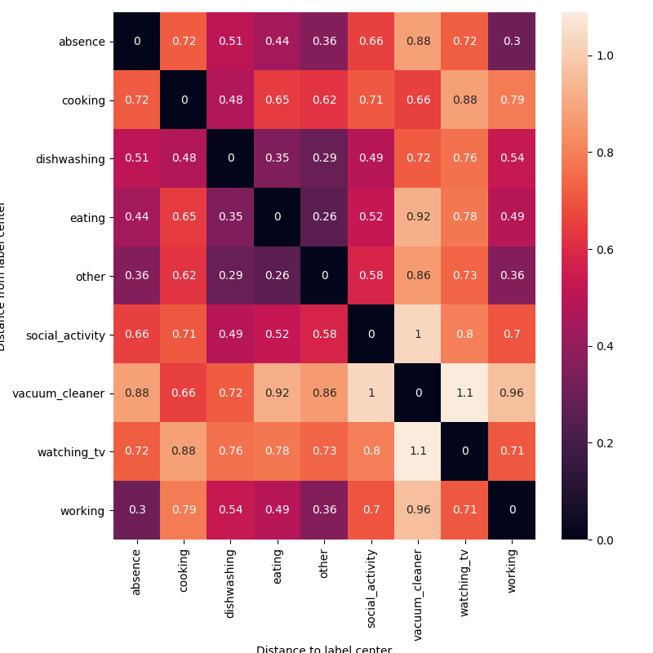
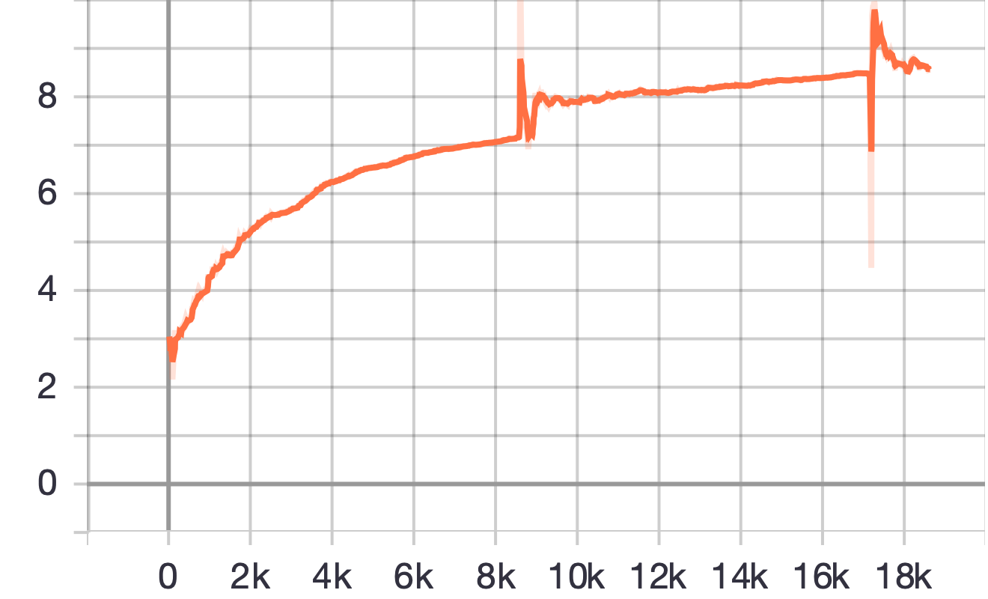
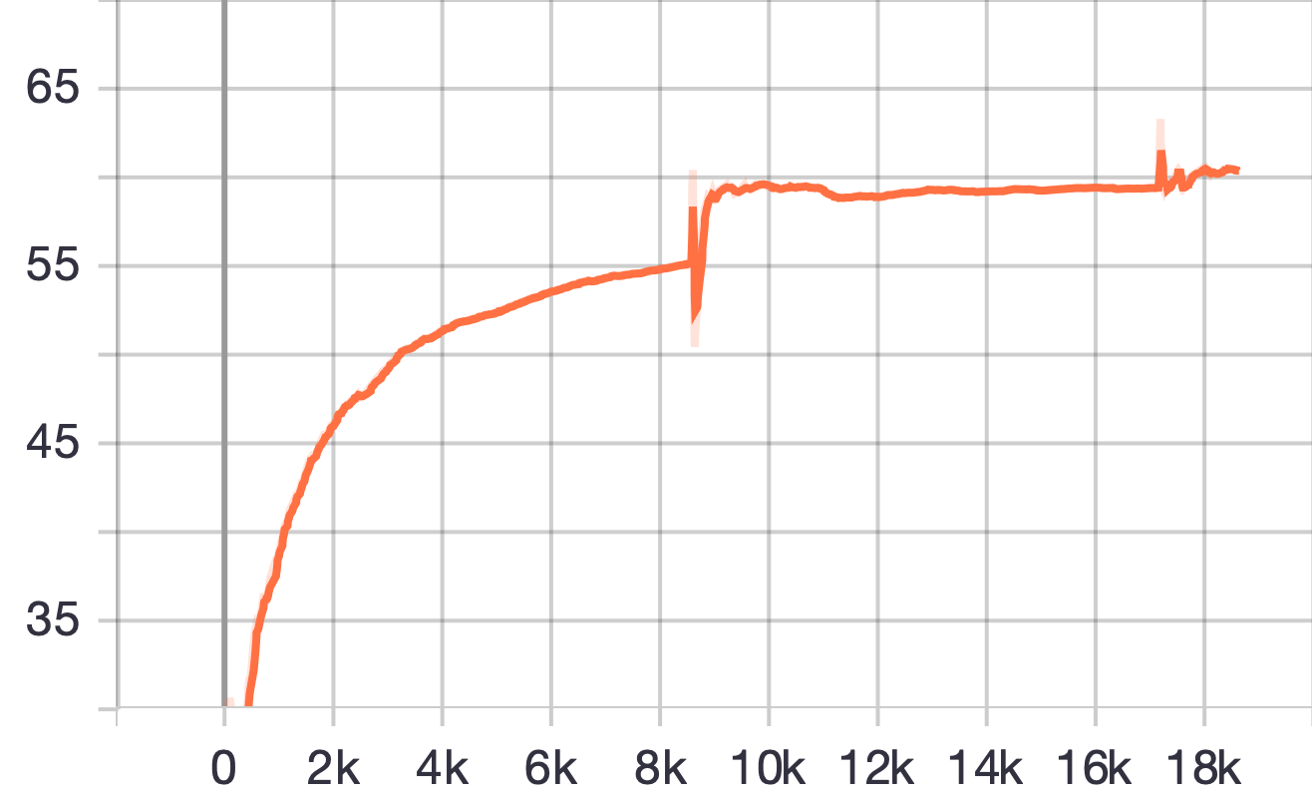
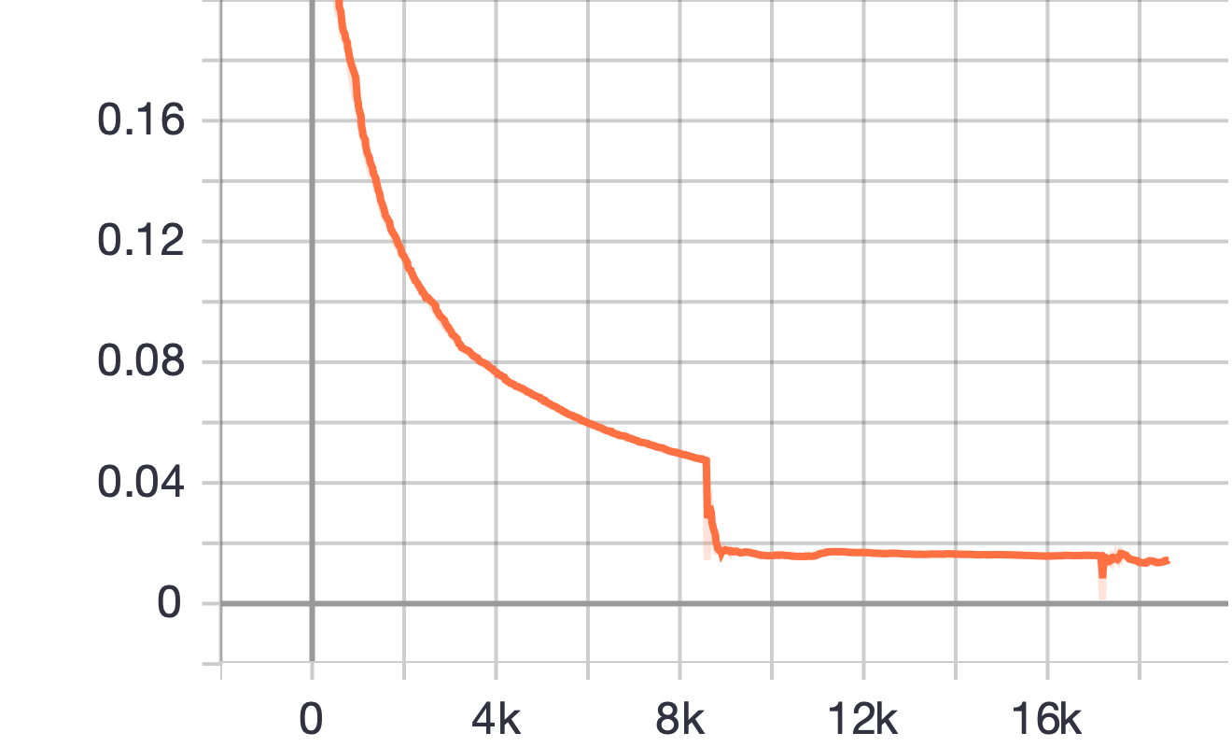
First results: Metrics
Distance neighbour²
Distance opposite²
Triplet loss

Slide 16
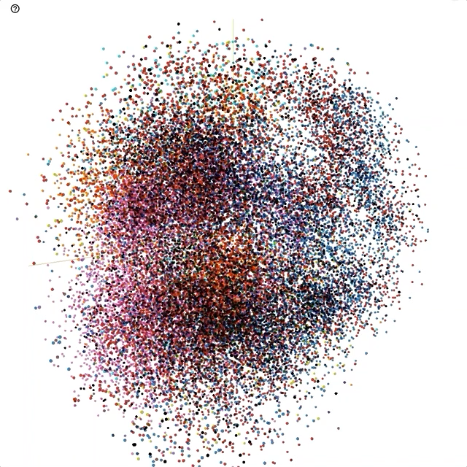
First results: Projection of embeddings

Slide 17
Summary and Outlook
Summary:
Create an embedding space for audio using an unsupervised triplet loss
Evaluate the embedding space for noise detection and music
Outlook:
Experiment with most suitable audio feature representation
Experiment with state-of-the-art architectures
Apply embedding architecture to music
Hyperparameter tuning for noise and music architecture
Examine and evaluate the clusters in the embedding space

Slide 18
Questions & Answers
Q & A

Slide 19
References
Introduction to Digital Signal Processing
[1] https://www.allaboutcircuits.com/technical-articles/an-introduction-to-digital-signal-processing/
Fundamentals of Music Processing
[2] Müller, Meinard. Fundamentals of Music Processing. Cham: Springer International Publishing, 2015. https://doi.org/10.1007/978-3-319-21945-5.
Deep Learning
[3] Goodfellow, Ian, Yoshua Bengio, and Aaron Courville. Deep Learning. MIT Press, 2016.
Triplet Loss
[4] https://omoindrot.github.io/triplet-loss
[5] Schroff, Florian, Dmitry Kalenichenko, and James Philbin. “FaceNet: A Unified Embedding for Face Recognition and Clustering.” 2015 IEEE Conference on Computer Vision and Pattern Recognition (CVPR), June 2015, 815–23. https://doi.org/10.1109/CVPR.2015.7298682.

Slide 20
References
Tile2Vec
[6] https://ermongroup.github.io/blog/tile2vec/
[7] Jean, Neal, Sherrie Wang, Anshul Samar, George Azzari, David Lobell, and Stefano Ermon. “Tile2Vec: Unsupervised Representation Learning for Spatially Distributed Data.” ArXiv:1805.02855 [Cs, Stat], May 30, 2018. http://arxiv.org/abs/1805.02855.
DCASE Challenge 2018 Task 5
[8] http://dcase.community/challenge2018/task-monitoring-domestic-activities

Slide 21
Related Work: Machine Learning
Unsupervised Learning: Identify patterns within unlabeled data
Supervised Learning: Approximate function from labeled data
References: [1]
Notes:
Recap the two
Unsupervised -> unknown patterns
Supvervised -> approximate functions from labeled data

Slide 22
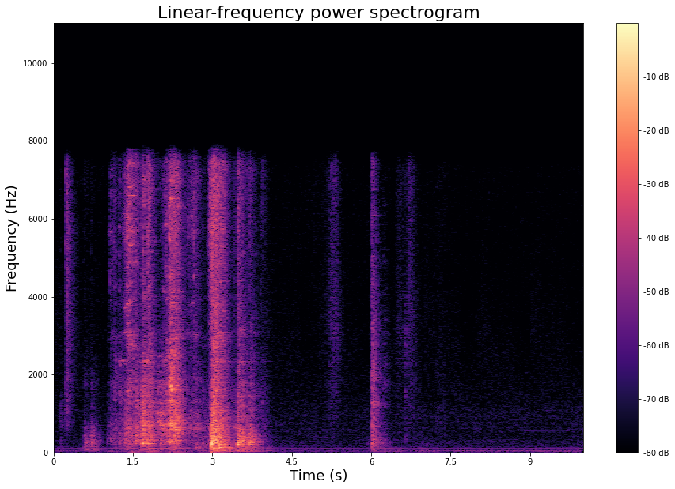
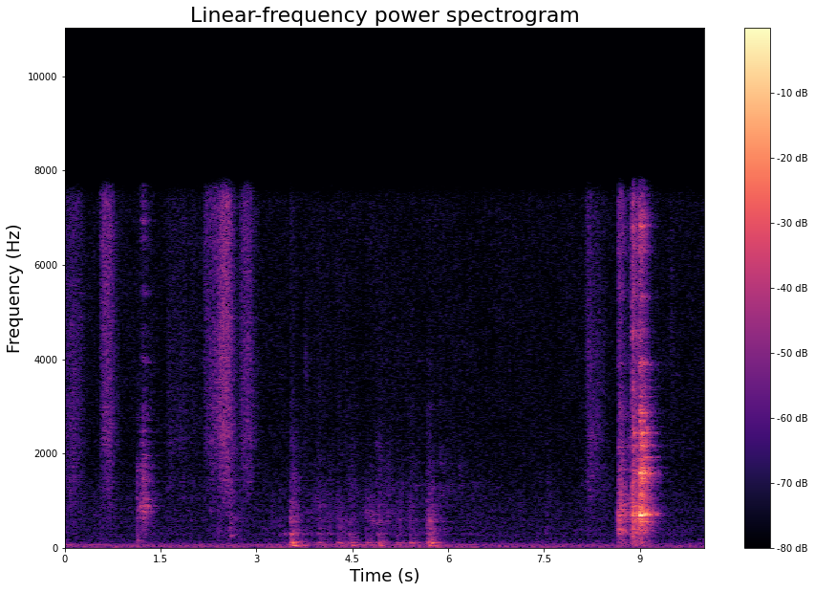
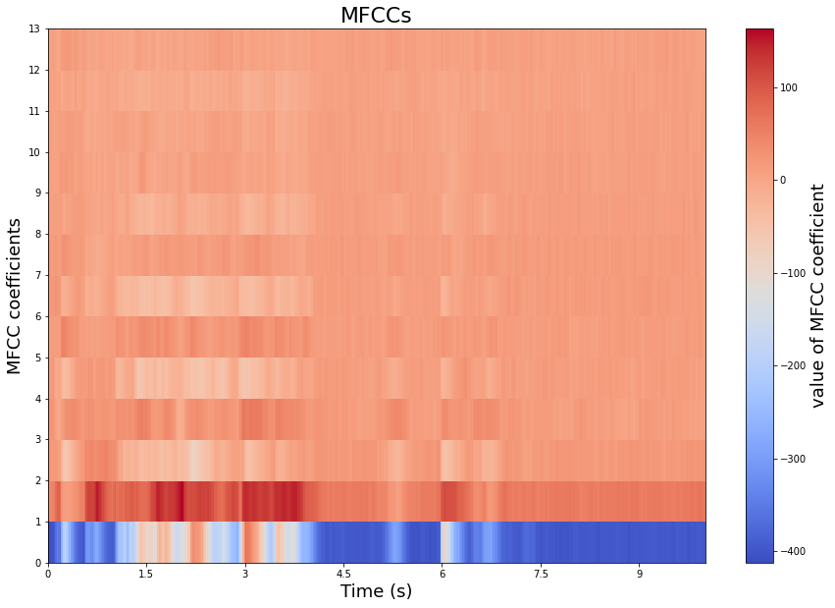
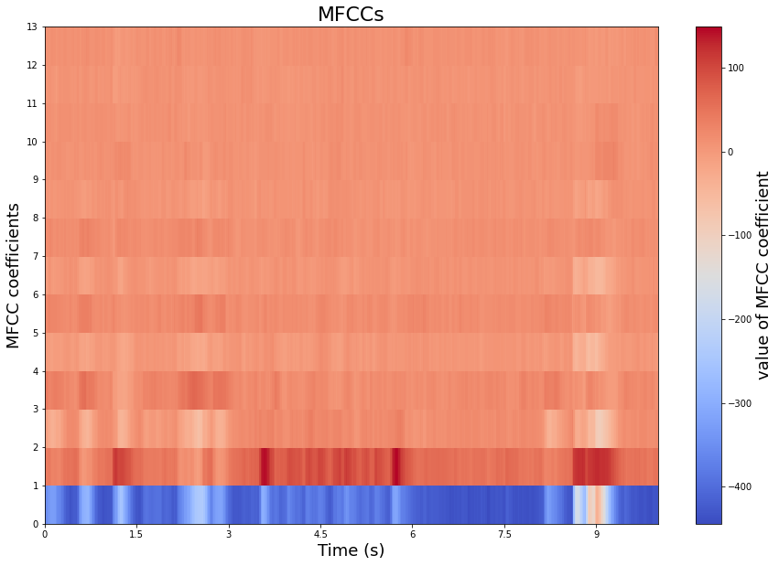

Datasets used: DCASE Challenge 2018 – Task 5 dataset and Music Dataset
Label: cooking
Label: dishwashing
References: [3]

